Slide 1
SQL INTECTION
BY JULIUS MUBAJJE, NAJAD A.B. ISSAK, NORA AMOIT AND JONATHAN

Slide 2
WHAT IS SQL INTECTION?
SQL stands for structured query language.
SQL Injection is code hacking technique in which the attacker adds SQL code to web form input box to access, view alter or modify a database.
Vulnerabilities occur when:
User input is incorrectly filtered for string literal, escape characters.
User input is not strongly typed.

Slide 3
SQL Injection in PHP
The following code is a very simple PHP application that accepts an id and shows the name of the user.
The application uses GET but it could use POST or any other HTTP method.
This example is based on the MySQL database but the same principles apply for other databases.
The sample database is called test with a table user and has the following structure and content;

Slide 4

Table user.

Slide 5
<?php
$name = '';
if (isset($_GET['id'])) {
$id = $_GET['id'];
$con = mysqli_connect("localhost","root","","test"); if(mysqli_connect_errno())
{
echo "Error occured while connecting with database ".mysqli_connect_errno();
}
$sql = "SELECT name FROM user WHERE id = $id";
$query = mysqli_query($con, $sql);
if ($query) {
while ($row = mysqli_fetch_assoc($query)) {
$name = $row['name'];
}
}
elseif(mysqli_error($con)){
mysqli_error($con);
}
}
?>

Slide 6
Testing the app
The following is an example of a legitimate HTTP request that could be made to the vulnerable application above.
http://localhost/library/dashboard.php?id=1
> admin
The following is an example of a malicious HTTP request that could be made to the vulnerable application above.
http://localhost/library/dashboard.php?id=-1 UNION SELECT pass FROM user where id=1
> admin.com

Slide 7
Issues with this app
Issue
Input Validation
Description
We know that the id that is passed will always be a number. However, the code does not validate user input at all.
Validating user input is not a direct solution to SQL Injection, but it helps us avoid malicious user data being interpreted by the database.
Suggested Remediation
Before even processing the database query, validate user input.
In this case, we need to check that the input value is a number.
.

Slide 8
Issues with this app
Issue
The code allows for SQL Injection
Description
The code accepts user input (in this case, from a GET parameter) and includes it directly in the SQL statement.
This allows an attacker to inject SQL into the query, therefore tricking the application into sending a malformed query to the database.
Suggested Remediation
When dealing with SQL queries that contain user input, use prepared statements also known as parameterized queries.
A parameterized query specifies parts of the SQL query that should be treated as user input.

Slide 9
Issues with this app
Issue
Errors are displayed to the user
Description
If errors are displayed, an attacker may get information that could lead to a compromise.
Information such as the database type and version makes it easier to exploit an SQL Injection vulnerability.
Suggested Remediation
Do not display SQL errors to the user. If you need to show the user an error, use a generic error message that does not give away sensitive information.

Slide 10
Issues with this app
Issue
Errors are not logged
Description
Error logs help you solve issues. They also let you find out if someone attempted to attack your application.
If you don’t keep a log of database errors, you miss the opportunity to gather information. This information could help you improve the security of your application before an attacker takes advantage of a vulnerability.
Suggested Remediation
Instead of showing database errors to the user, log them to a file. The file must not be accessible to an attacker via the web server.
You can log errors to the PHP error log or to a file of your choice.

Slide 11
Solving issues

Slide 12
WHAT CAN SQL INJECTION DO?
Retrieve sensitive information
Usernames/ Passwords
Credit Card information
SSN
Manipulate Data
Delete records
Truncate tables
Insert records
Manipulate Database Objects
Drop tables
Drop databases

Slide 13
WHAT CAN SQL INJECTION DO? CONT.
Retrieve System Information
Identify software and version information
Determine server hardware
Get a list of databases
Get a list of tables
Get a list of column names within tables
Manipulate User Accounts
Create new sysadmin accounts
Insert admin level accounts into the web-app
Delete existing accounts

Slide 14
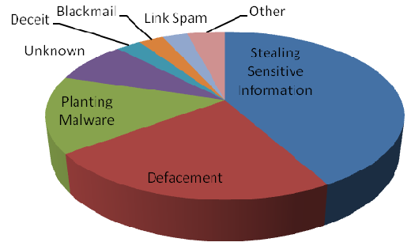
IMPACT OF SQL INJECTION
Leakage of sensitive information.
Reputation decline.
Modification of sensitive information.
Loss of control of db server.
Data loss.
Denial of service.

Slide 15
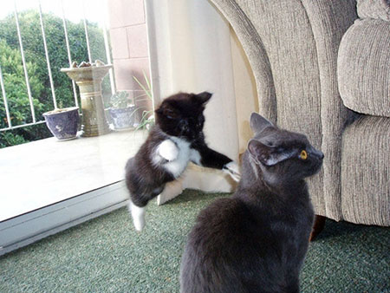
IDENTIFYING ATTACKS

Slide 16
IDENTIFYING ATTACKS
Evaluate profiler results
Look for injected SQL statements
Look for non-parameterized queries
Look for expensive queries (Injected SQL?)
Various Tools:
WebInspect by HP
http://sqlninja.sourceforge.net/
Web Vulnerability Scanners
Acunetix (www.acunetix.com)
Look for anything suspicious
Check source code for vulnerabilities

Slide 17
STRATEGIES TO STOP SQL INJECTION ATTACKS
Write code to identify and replace suspect looking strings?
Not a good idea
Impossible to identify all possible scenarios
Check incoming values before executing a query
If expecting a character value with a length of 2, use a substring with a length of 2.
Check datatype and/or length of incoming values
(integer, char(2), etc)
Encrypt URL variable strings

Slide 18
CONT.
Use a web application firewall (WAF)
Don't return error messages to the screen (suppress error messages)
Remove escape characters
Some languages have functions to help with this
Implement proper security
Use db_datareader, db_datawriter, or table level permissions
Not db_owner or sysadmin!
Encrypt sensitive data in the database
ALWAYS use Parameterized queries where user input is possible
Use on all queries using a GET or POST

Slide 19
PARAMETERIZED QUERIES
An execution plan is created on the server before the query is executed. The plan only allows the original query to be executed.
Injected SQL will not be executed because it is treated as a value and not as a statement.

Slide 20
PARAMETERIZED QUERIES – CODE EXAMPLE
Not Safe (Non-Parameterized)
$tsql_States = sprintf("SELECT * FROM vw_DimState WHERE stateCode='%s' AND countryCode='%s'", $_GET[‘State’], $_GET[‘Country’]);
$stmt_States = sqlsrv_query($conn, $tsql_States);
$row_States = sqlsrv_fetch_array($stmt_States, SQLSRV_FETCH_ASSOC);
Safe (Parameterized)
$tsql_States = "SELECT * FROM vw_DimState WHERE stateCode=? AND countryCode=?";
$params_States = array($_GET[‘State’], $_GET[‘Country’]);
$stmt_States = sqlsrv_query($conn, $tsql_States, $params_States);
$row_States = sqlsrv_fetch_array( $stmt_States, SQLSRV_FETCH_ASSOC);

Slide 21
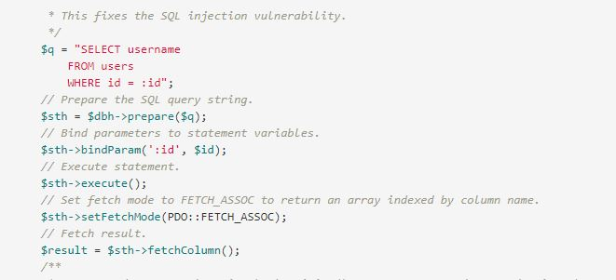
PARAMETERIZED QUERIES – OOP CODE EXAMPLE

Slide 22
SUMMARY
SQL injection is technique for exploiting applications that use relational databases as their back end.
Applications compose SQL statements and send to database.
SQL injection use the fact that many of these applications concatenate the fixed part of SQL statement with user-supplied data that forms WHERE predicates or additional sub-queries.

Slide 23
CONT.
The technique is based on malformed user-supplied data
Transform the innocent SQL calls to a malicious call
Cause unauthorized access, deletion of data, or theft of information
All databases can be a target of SQL injection and all are vulnerable to this technique.
The vulnerability is in the application layer outside of the database, and the moment that the application has a connection into the database.
Link to all assets & code for this presentation
https://github.com/thecodehive/library

